Slide 1


Bahçeşehir University
Data Mining For Business Intelligence;
Data Mining Tools & Techniques for Business Intelligence
By Lamiss Gargouri
Advisor: Mr Atinç Yilmaz

Slide 2
Abstarct
Background
This thesis examines the use of data mining tools and techniques in the context of business intelligence. It explains the fundamental concepts of business intelligence and data mining, as well as how they can be integrated to improve business analytics. A practical application and case study is also offered, demonstrating the use and promise of data mining techniques in a real-world environment.

Slide 3
Outlines
01
Introduction
02
Literary Review
03
Business Intelligence
04
Data Mining
05
Data Warehouse
06
DM for BI
07
Experimental Studies
08
Conclusion

Slide 4
Introduction

Slide 5



Introduction
Business intelligence is an important component of successful enterprises, enabling businesses to make data-driven decisions by leveraging large amounts of data. Data mining is an important approach to this, enabling businesses to find useful patterns and trends.
This study explores the relationship between song features and their popularity levels, using machine learning techniques to develop a predictive model. It has the potential to revolutionize the music industry by improving recommendation systems, providing insights to artists and record labels, and showcasing the power of data-driven decision making.

Slide 6


Impact 1
Impact on Daily Life
Music recommendation systems should consider factors such as tempo, duration, and artist to create personalized recommendations based on user preferences and listening history.
Impact 2
Analyzing song features and popularity can provide valuable insights to the music industry, helping artists, producers, and record labels make decisions related to song production, marketing, and promotion.
Impact 3
Data analysis and machine learning techniques can be used to gain insights and make informed decisions in various domains, not limited to the music industry.

Slide 7
Literary Review

Slide 8
Data Virtualization for Business Intelligence Systems: Revolutionizing Data Integration for Data Warehouses (Morgan Kaufmann Series on Business Intelligence)
﻿Literary Review
01
Integration of Data Mining in Business Intelligence Systems (Ana Azevedo and Manuel Filipe Santos .
02
Web Data Mining and Applications in Business Intelligence and Counter-Terrorism (Bhavani Thuraisingham)
03
Applied Data Mining for Business Intelligence (Niels Arnth-Jensen)
04

Slide 9
Business Intelligence

Slide 10
Business Intelligence
Definition
BI is the process of collecting, analyzing, and turning raw data into meaningful and actionable information for corporate decision-making. Advantages include improved decision-making, operational efficiency, enhanced data-driven strategies, better identification of opportunities and hazards, and improved performance and competitiveness.

Slide 11

The Importance of Business Intelligence
Improved decision-making.
Increased efficiency.
Competitive advantage.
Improved customer satisfaction.
Enhanced risk management

Slide 12
Concepts & Applications of BI
Concepts:
Data warehousing
Data mining
Data visualization
Dashboards
Reporting
Predictive analytics
Scorecards
Spatial analysis
Mobile BI
Collaboration & sharing
Applications
Sales analysis
Customer analysis
Supply chain analysis
Financial analysis
Operations analysis

Slide 13
Business Intelligence Tools
Tableau
Power BI
SAP BusinessObjects
IBM Cognos

Slide 14
Data Mining

Slide 15
Data Mining
Definition
Data mining is the process of extracting valuable information from data sets to uncover hidden patterns, relationships, and trends. It can be applied to various industries and domains, using statistical analysis, machine learning algorithms, and domain expertise.

Slide 16
The Usage of
Data Mining
Market analysis
Fraud detection
Customer Relationship management
Predictive modeling
Text mining
Optimization

Slide 17

Data Mining Techniques
Tool 1 :
Decision Trees
Tool 2:
Support Vector Machine (SVM)
Tool 3:
Adaboost (Adaptive Boosting)
Tool 4:
Logistic Regression
Tool 5:
K-Nearest Neighbor (KNN)
Tool 6:
Random Forest Classifier

Slide 18
Tools Used in
Data Mining
WEKA
RapidMiner
KNIME
Orange
Rattle

Slide 19

Data Mining Stages
Stage 1 :
Business Understanding
Stage 2:
Data understanding
Stage 3:
Data preparation
Stage 4:
Modeling
Stage 5:
Evaluation
Stage 6:
Deployment
Stage 7:
Review

Slide 20
Data Warehouse

Slide 21
Data Warehouse
Definition
A data warehouse is a large, centralized repository of structured, organized, and integrated data from various sources within an organization. It is designed to support efficient data analysis, reporting, and business intelligence activities.

Slide 22

Data Warehouse Architecture
Element 1 :
Data Sources
Element 2:
ETL (Extract, Transform, Load)
Element 3:
Data Warehouse Database
Element 4:
Data Marts
Element 5:
Business Intelligence
Element 6:
Data Lakes
Element 7:
Clous-based data warehouses

Slide 23

Data Loading Processes
Extraction
1.
2.
Transformation
3.
Loading

Slide 24

Data Warehouse
Access
User Authentication
Authorization
Access Controls
Data Security
Data Governance

Slide 25

Data Warehouse Development Approaches
Approach 1 :
Top-down approach
Approach 2:
Bottom-up approach
Approach 3:
Hybrid approach
Approach 4:
Incremental approach
Approach 5:
Data mart approach

Slide 26
Data Mining
For
Business Intelligence

Slide 27
DM for BI
Background
Data mining is essential for business intelligence by extracting valuable insights, enabling predictive analytics, supporting market analysis, managing risks, and improving operational performance. It helps identify emerging trends, evaluate market opportunities, and assess competitive position.

Slide 28
How DM & BI are related
Data Source:
Data mining and business intelligence use structured and unstructured data sources to analyze and report on data.
Data Analysis:
Data mining techniques are used to extract insights and knowledge from data.
Decision Support:
Data mining provides valuable insights for decision-making, enabling users to explore and interpret the data.
Goal Alignment:
Data mining helps identify patterns, while business intelligence transforms findings into actionable information.

Slide 29
Data Mining
For
Business Intelligence

Slide 30
The Role Data Mining Plays for BI
Knowledge Discovery
Decision Support
Predictive Analytics
Customer Segmentation and Targeting
Market Analysis and Competitive Intelligence
Risk Management and Fraud Detection
Performance Optimization
Pattern Recognition and Data Visualization
Market Segmentation and Product Development
Data-Driven Insights

Slide 31

The Industries That Benefit From DM in BI
Industry 1 :
Retails
Industry 2:
Health Care
Industry 3:
Financial Services
Industry 4:
Manufacturing
Industry 5:
Telecommunications
Industry 6:
Government

Slide 32
The Challenges of Data Mining in BI
Large, Complex Datasets
Data Quality Issues
Organizational and Cultural Barriers
Keeping Up With Change
Ethical and Legal Considerations
Integration With Existing Systems
Limited Data Availability
Insufficient Resources

Slide 33
The Cloud & The Future of DM for BI
Scalability & Flexibility
Cost Efficiency
Accessibility and Collaboration
Integration and Data Management
Advanced Analytics and Machine Learning
Real-Time and Streaming Analytics
AI and Automation
Enhanced Security and Data Governance

Slide 34
Key Differences Between DM & BI
DM uses advanced techniques to identify patterns, BI uses visualization and reporting.
DM focuses on uncovering patterns, while BI presents data for decision-making.
BI uses tools to visualize data, while DM uses algorithms.
DM is used to analyze structured data, while BI is used to analyze both structured and unstructured data.

Slide 35
Experimental
Studies

Slide 36
Experimental Studies
Introduction
The popularity of songs on music streaming services is a major factor in user engagement and satisfaction. To leverage the power of data science and machine learning, a predictive model must be developed that accurately determines the popularity of songs based on current and historical features. This model can improve user experiences and can be applied to other music streaming services.

Slide 37
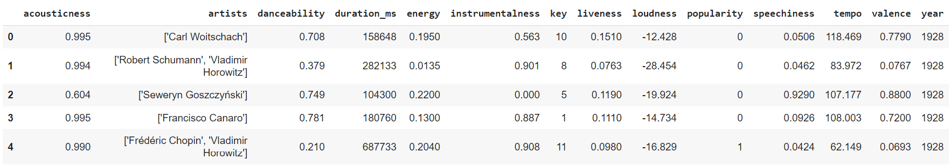
Dataset
This dataset contains almost 160.000 songs gathered via the Spotify Web API. The information comes from Spotify and comprises 169k songs from 1921 to 2020. Every year, the top 100 songs are released.
The link where I have found my dataset:
https://www.kaggle.com/datasets/ektanegi/spotifydata-19212020/code

Slide 38

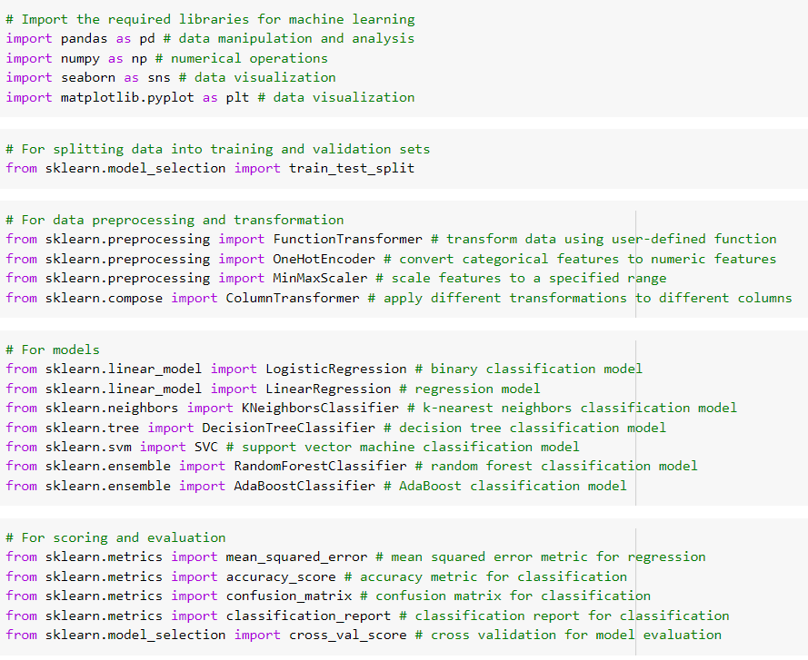
Importing Librairies
pandas & numpy
seaborn & matplotlib
train_test_split
curve_fit, FunctionTransformer, OneHotEncoder, MinMaxScaler, and ColumnTransformer
LogisticRegression, KNeighborsClassifier, DecisionTreeClassifier, SVC, LinearRegression, RandomForestClassifier, and AdaBoostClassifier
mean_squared_error, accuracy_score, confusion_matrix, cross_val_score, and classification_report

Slide 39
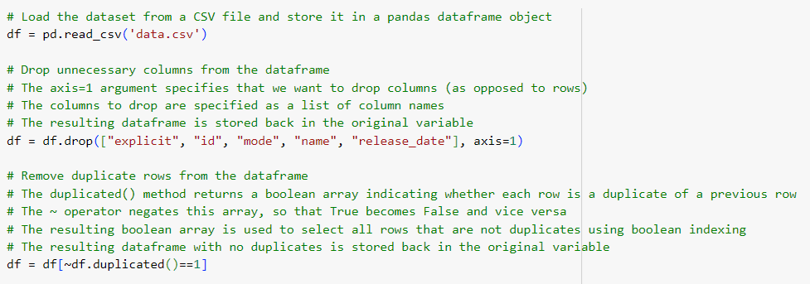
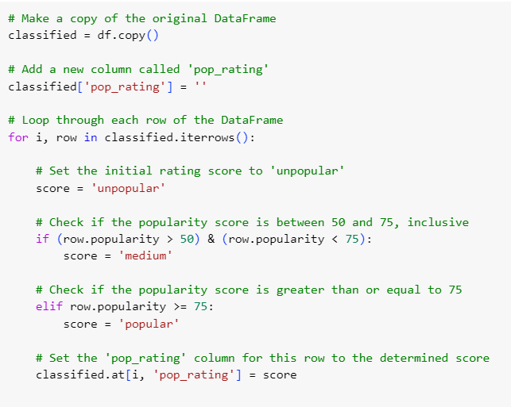
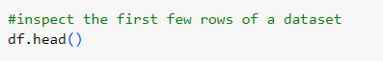
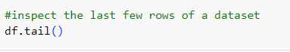
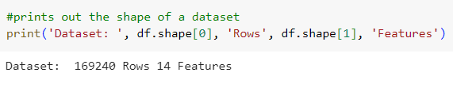
Data Visualization

Slide 40
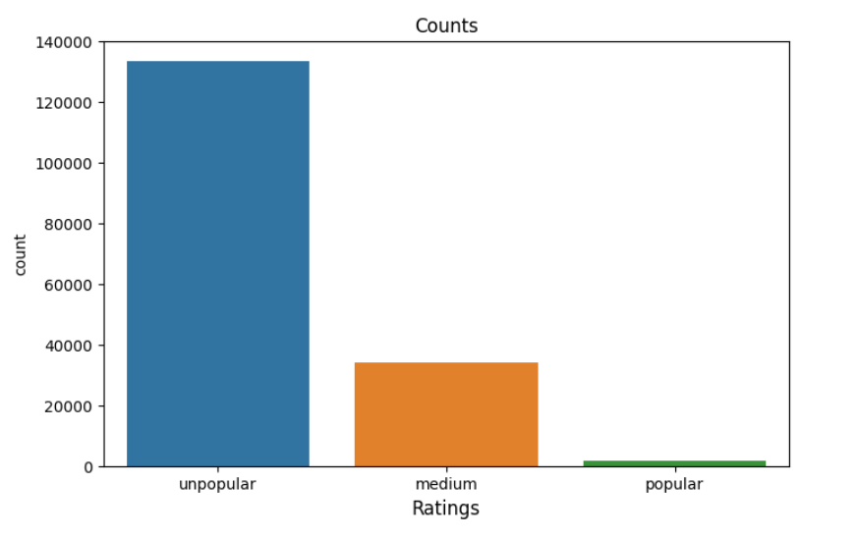
Data Visualization
The countplot appears to show the distribution of a categorical variable pop_rating, which has three possible values: "unpopular", "medium", and "popular".

Slide 41
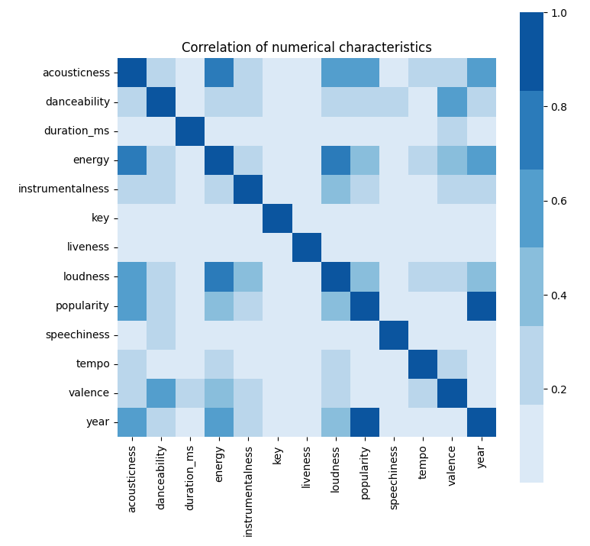
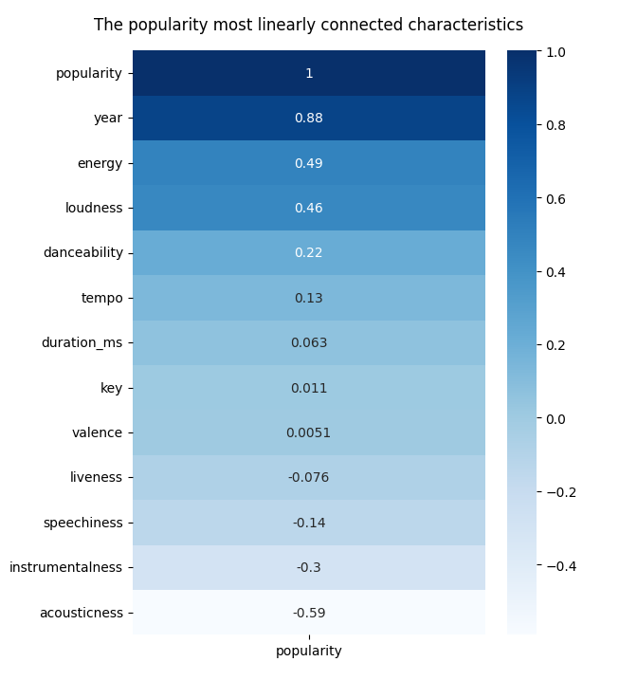
Exploratory Data Analysis (EDA)
The Relationship Between all the Features

Slide 42
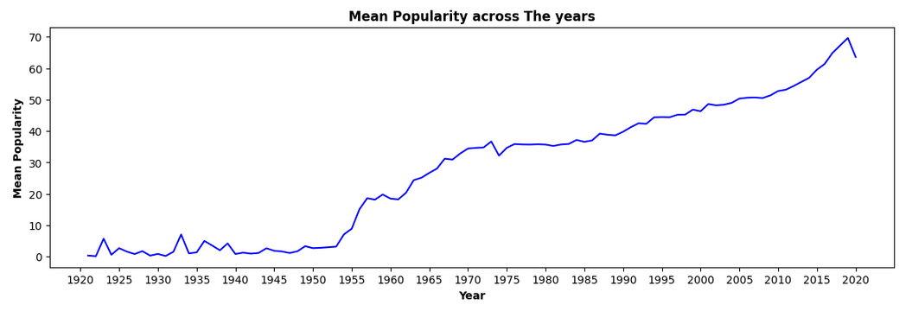
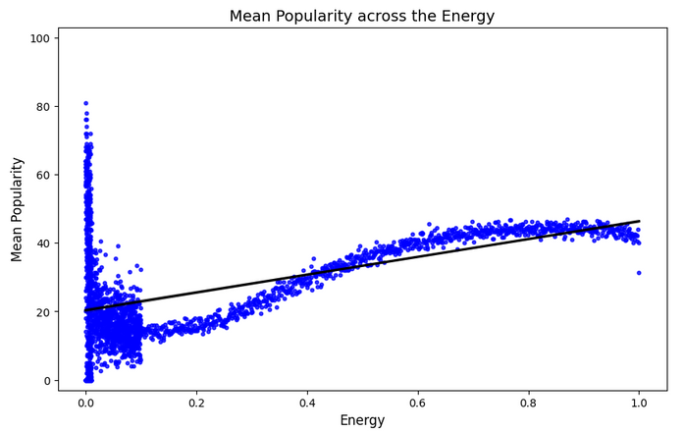
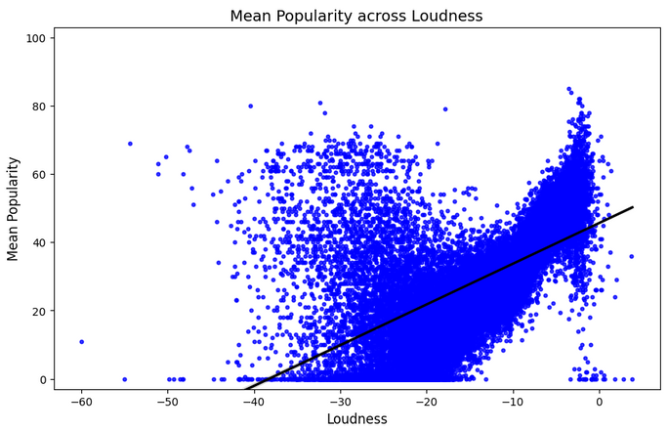
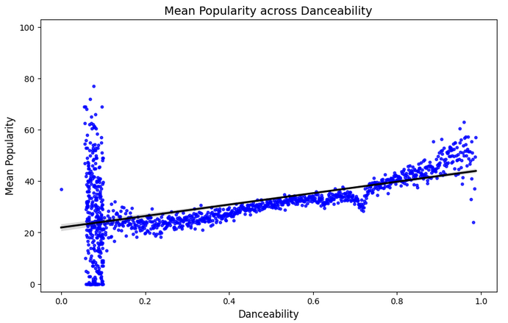
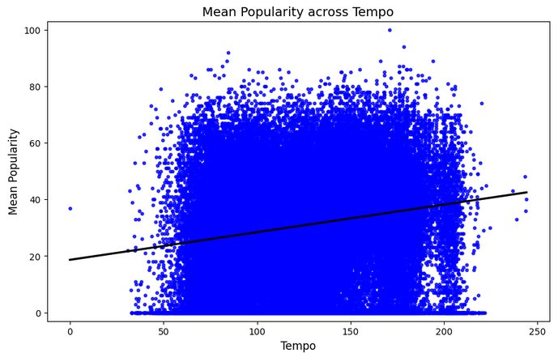
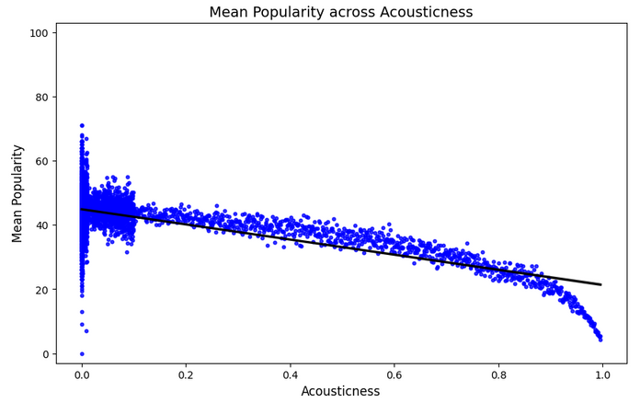

Slide 43
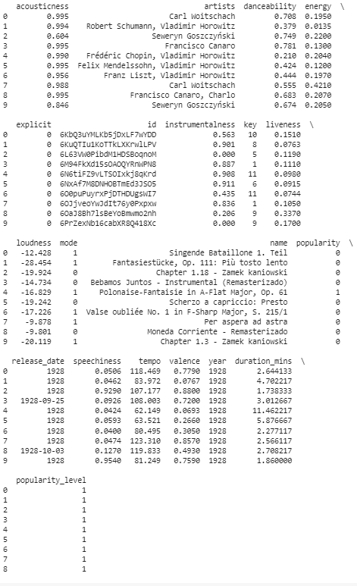
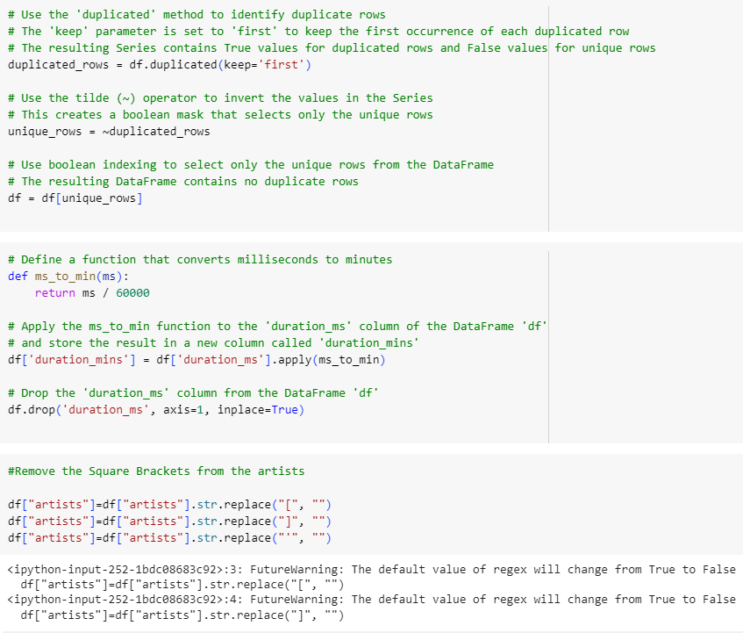
Initialisation

Slide 44
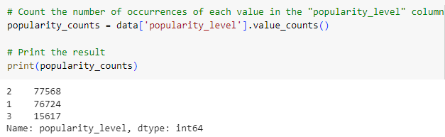
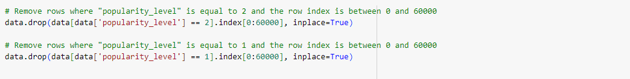
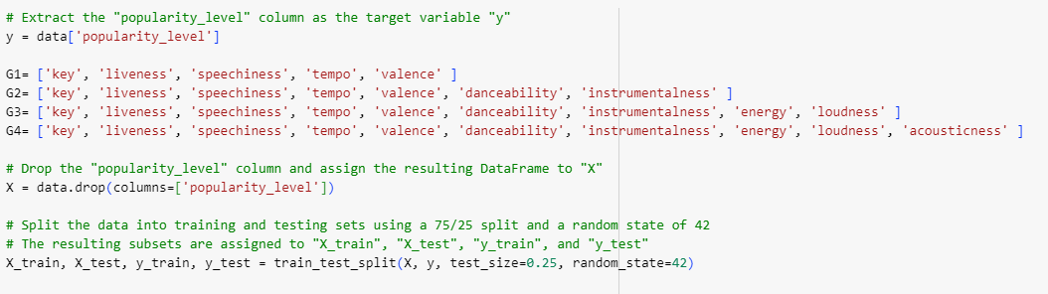
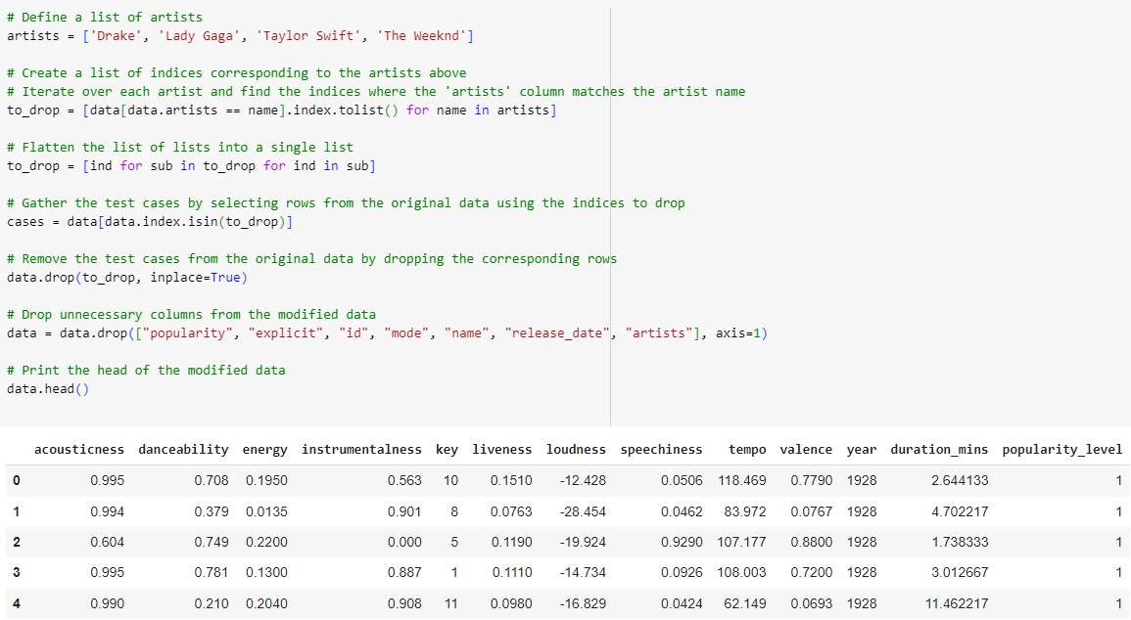
Initialisation

Slide 45
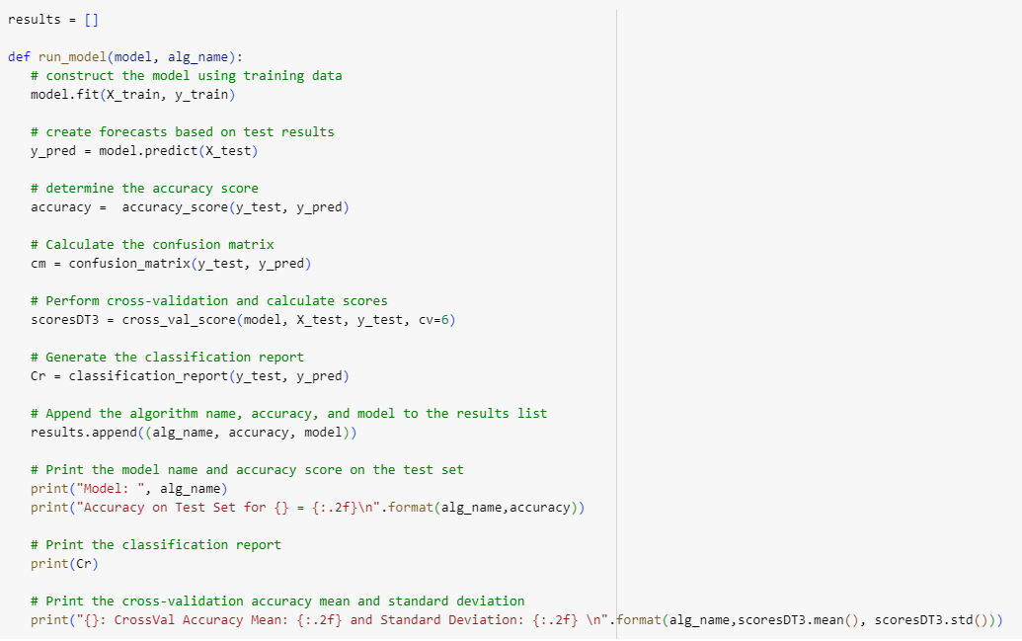
Prediction Models
Run_model is a function that takes a machine learning model and its algorithm name and trains it on a training and test dataset, making predictions and evaluating its performance.

Slide 46
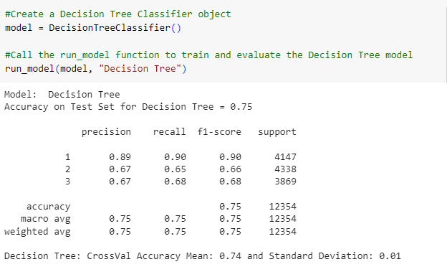
Prediction Models
Decision Trees
Execution of a simple decision tree classifier
Accuracy on Test Set for Decision Tree = 0.74
Precision, Recall, F1-Score, and Support
Accuracy, Macro Average, and Weighted Average
·Decision Tree: CrossVal Accuracy Mean: 0.74 and Standard Deviation: 0.00.

Slide 47
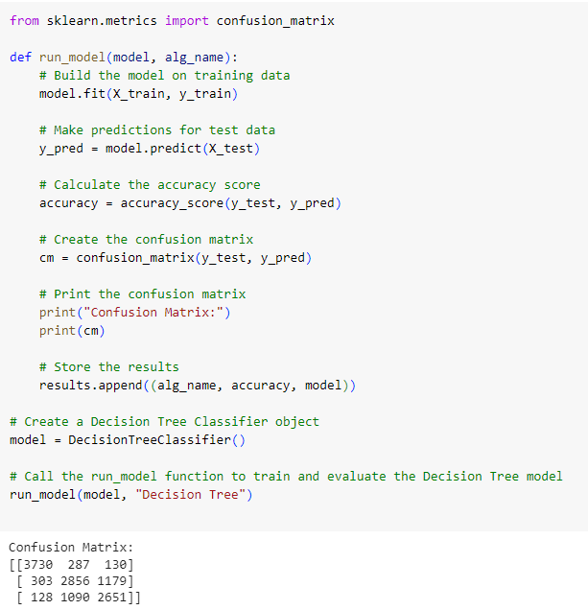
Prediction Models
Decision Trees
3729 correctly predicted, 286 false positives, and 132 false positives.
The middle-left cell has 323 false negatives, the middle-middle cell has 2854 true positives, and the middle-right cell has 1161 false positives.
128 in the bottom-left cell is false negative, 1115 in the bottom-middle cell is false negative, and 2626 in the bottom-right cell is true positive.

Slide 48
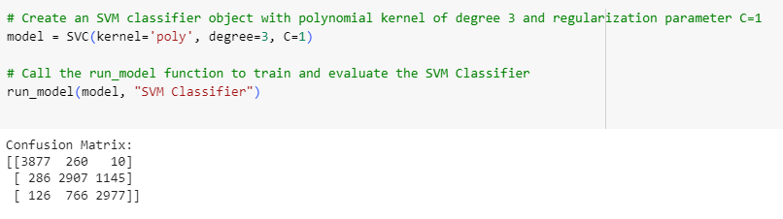
Prediction Models
Support Vector Machine(SVM) Classifier
True positives = 3877, false positives = 260, and false positives = 10
False negatives= 286, true positives= 2907, and false positives= 1145
False negatives= 126, false negatives=766, and true positives= 2977

Slide 49
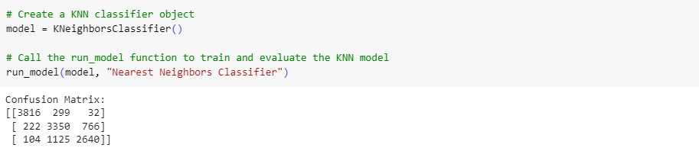
Prediction Models
K-Nearest Neighbor (KNN) Classifier
True positives = 3816, false positives = 299, and false positives = 32
False negatives= 222, true positives= 3350, and false positives= 766
False negatives= 104, false negatives=1125, and true positives= 2640

Slide 50
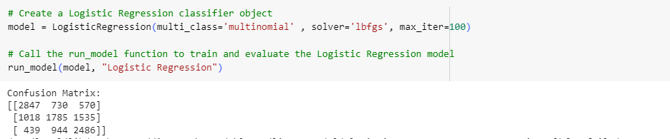
Prediction Models
Logistic Regression
True positives = 2847, false positives = 730, and false positives = 570
False negatives= 1018, true positives= 1785, and false positives= 1535
False negatives= 439, false negatives=944, and true positives= 2486

Slide 51
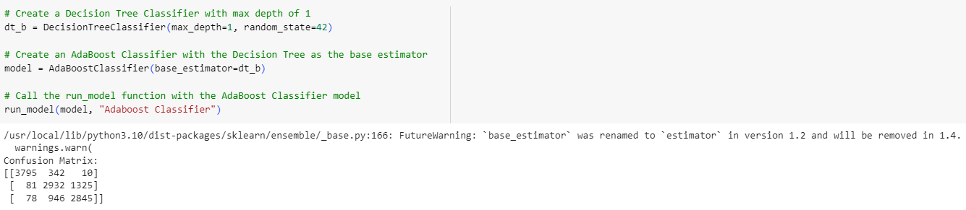
Prediction Models
Adaboost Classifier
True positives = 3795, false positives = 342, and false positives = 10
False negatives= 81, true positives= 2932, and false positives= 1325
False negatives= 78, false negatives=946, and true positives= 2845

Slide 52
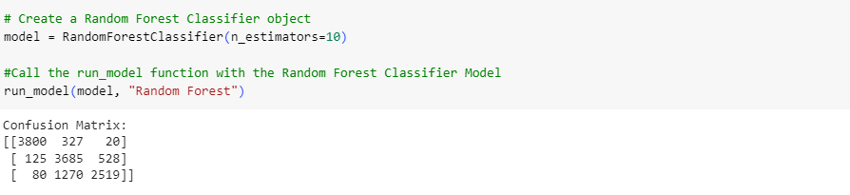
Prediction Models
Random Forest Classifier
True positives = 3800, false positives = 327, and false positives = 20
False negatives= 125, true positives= 3685, and false positives= 528
False negatives= 80, false negatives=1270, and true positives= 2519

Slide 53
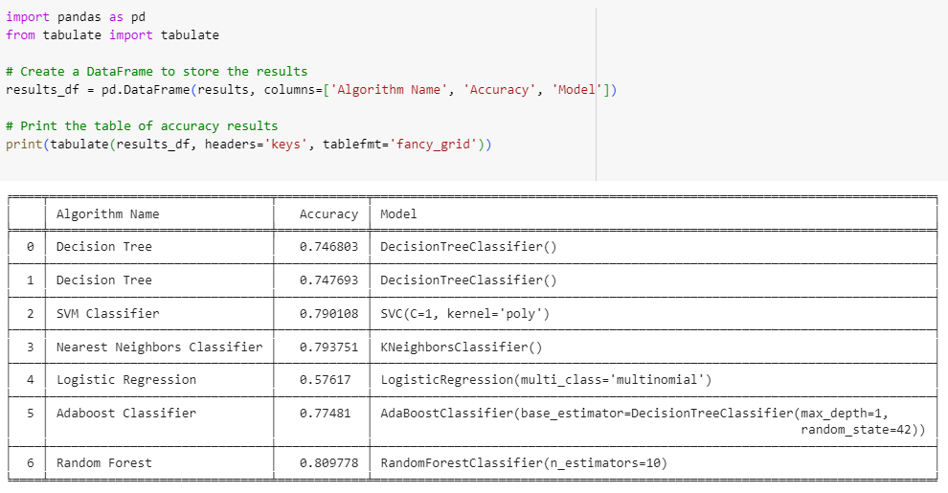
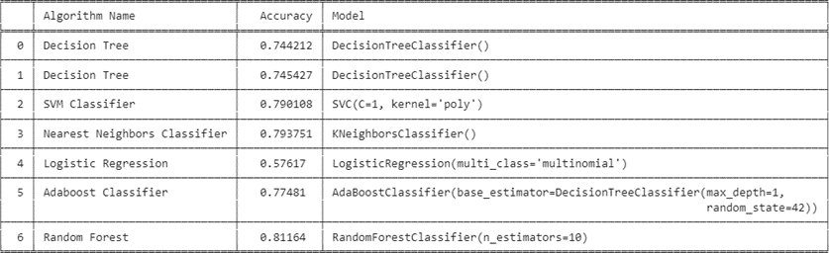
Results

Slide 54
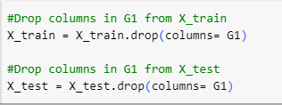
Test

Slide 55
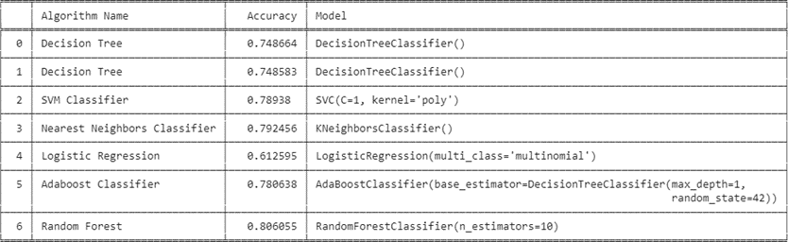
Remove G1

Slide 56

Remove G2

Slide 57

Remove G3

Slide 58
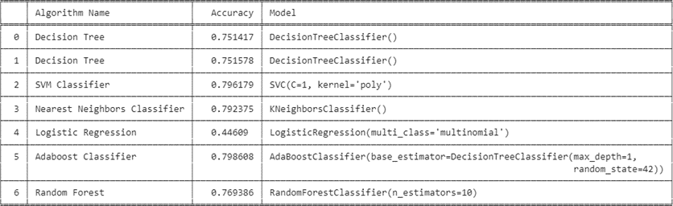
Remove G4

Slide 59
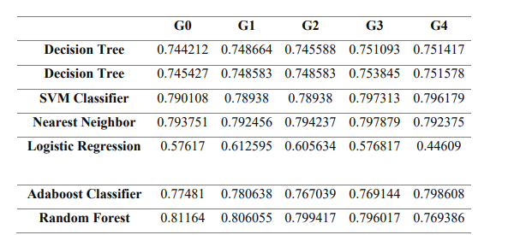
Comarison Table

Slide 60
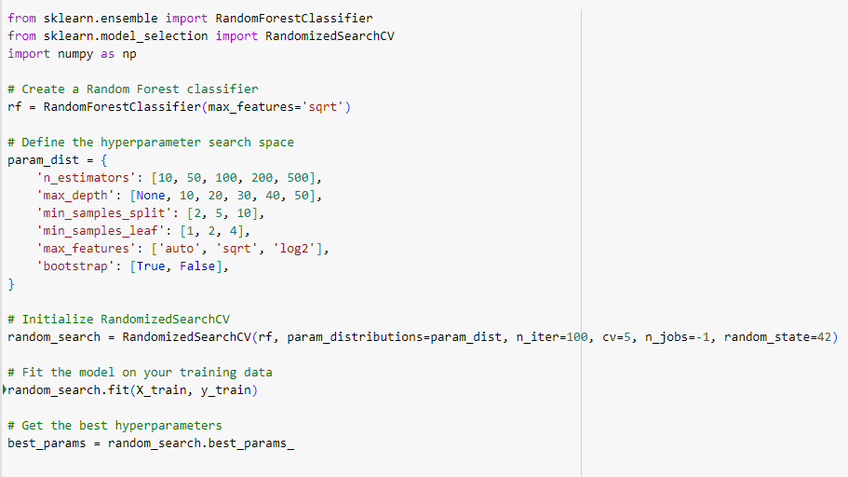
Fine Tuning

Slide 61
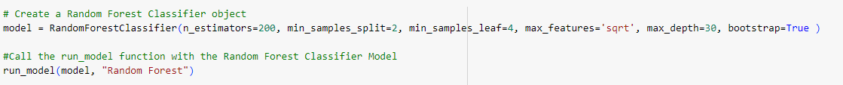
Fine Tuning
Best Parameters
n_estimators =200
min_samples_split= 2
min_samples_leaf= 4
max_features= 'sqrt'
max_depth= 30
bootstrap= True
=> By changing these parameters the best accuracy = 0.821515

Slide 62
Conclusion

Slide 63
Conclusion
Discussion
This thesis investigated the use of data mining tools and techniques in business intelligence. It discussed various strategies and algorithms for detecting patterns and trends in massive datasets, as well as the function of data warehousing. The Random Forest algorithm performed best when all characteristics were incorporated, while other algorithms performed better after removing features with low significance scores.

Slide 64
Bahçeşehir University
Thank You
By Lamiss Gargouri
Advisor: Mr Atinç Yilmaz

